Slide 1
Announcements
Homework 4 will be posted tonight (due 11/3 at 11:59pm)

Slide 2
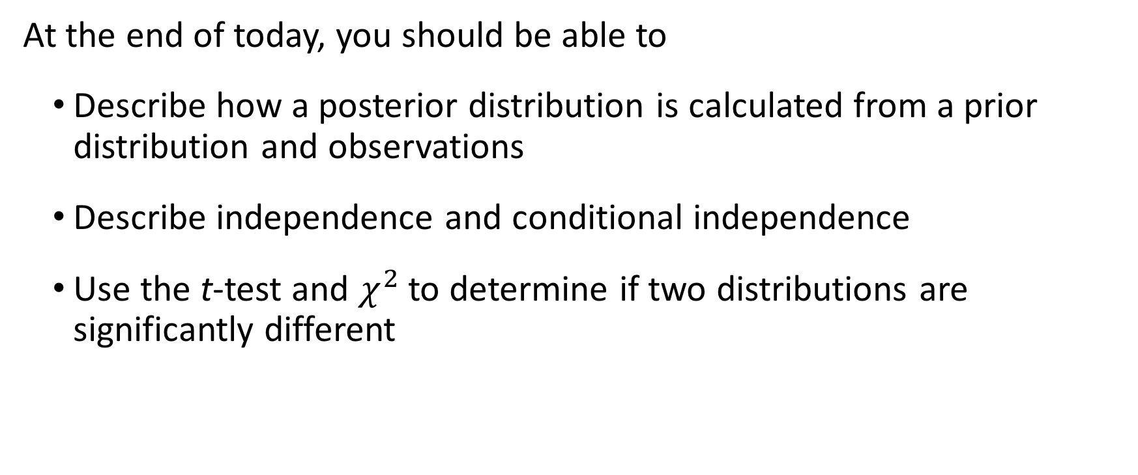
Today’s learning goals
At the end of today, you should be able to
Describe how a posterior distribution is calculated from a prior distribution and observations
Describe independence and conditional independence
Use the t-test and $χ^{2}$ to determine if two distributions are significantly different

Slide 3







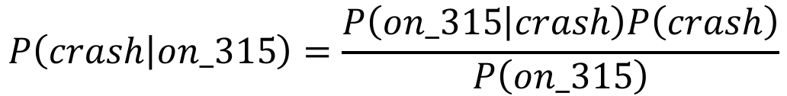
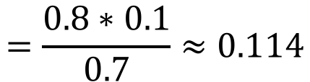
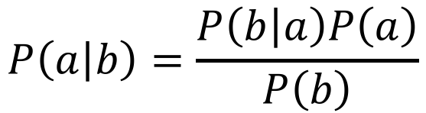
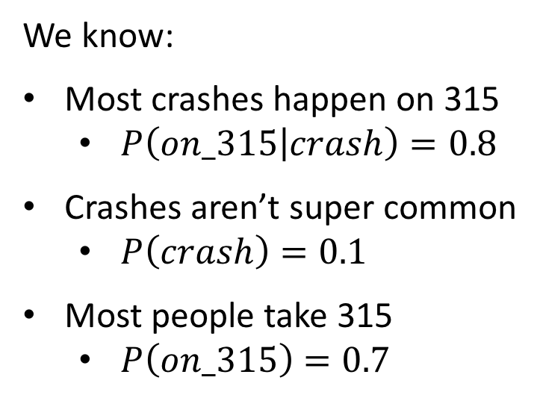
From last time: Is 315 safe?
We know:
Most crashes happen on 315
$P\left(on_315 | crash\right)=0.8$
Crashes aren’t super common
$P\left(crash\right)=0.1$
Most people take 315
$P\left(on_315\right)=0.7$
$$P\left(crash | on_315\right)=\frac{P\left(on_315 | crash\right)P\left(crash\right)}{P\left(on_315\right)}$$
Bayes’ rule
$$P\left(a | b\right)=\frac{P\left(b | a\right)P\left(a\right)}{P\left(b\right)}$$
$$=\frac{0.8∗0.1}{0.7}≈0.114$$
Notes:
This was Bayesian inference! (so sneaky)

Slide 4
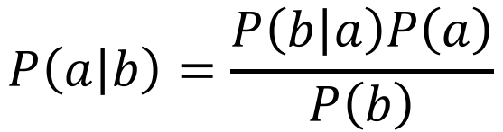
Calculating posteriors from observations
Bayes’ Rule
$$P\left(a | b\right)=\frac{P\left(b | a\right)P\left(a\right)}{P\left(b\right)}$$
a is the variable of interest
b is the observed evidence
Prior probability – the initial likelihood of observing a, before we observe any evidence
A priori!
Posterior probability – the adjusted likelihood of observing a, after taking observed evidence into account

Slide 5
From last time: Is 315 safe?
We know:
Most crashes happen on 315
$P\left(on_315 | crash\right)=0.8$
Crashes aren’t super common
$P\left(crash\right)=0.1$
Most people take 315
$P\left(on_315\right)=0.7$
$$P\left(crash | on_315\right)=\frac{P\left(on_315 | crash\right)P\left(crash\right)}{P\left(on_315\right)}$$
Bayes’ rule
$$P\left(a | b\right)=\frac{P\left(b | a\right)P\left(a\right)}{P\left(b\right)}$$
$$=\frac{0.8∗0.1}{0.7}≈0.114$$
Notes:
Here, being on_315 is the observed evidence; 11% is the posterior

Slide 6
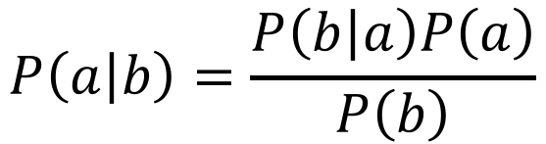
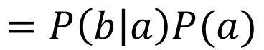
Posteriors with fixed observations
With fixed (i.e., non-random) observations, posterior calculation simplifies:
Bayes’ Rule
$$P\left(a | b\right)=\frac{P\left(b | a\right)P\left(a\right)}{P\left(b\right)}$$
$$=P\left(b | a\right)P(a)$$
a is the variable of interest
b is the observed evidence
Assume this to be 1

Slide 7
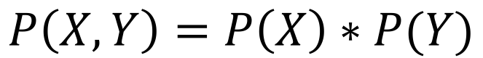
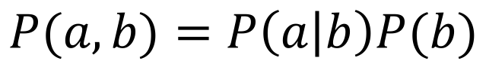
Independent variables
Two random variables X and Y are said to be independent if:
$$P\left(X,Y\right)=P\left(X\right)∗P(Y)$$
What does this mean?
Remember the Product Rule:
If X and Y are independent, then the likelihood of seeing either one is unaffected by if we see the other.
$$P(a,b)=P\left(a | b\right)P(b)$$

Slide 8
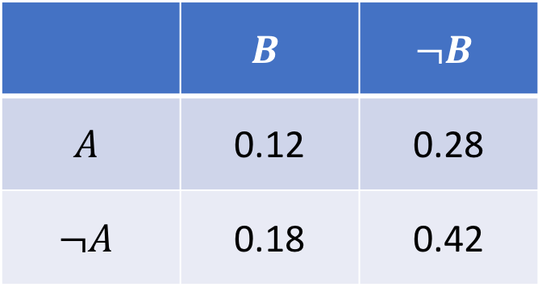
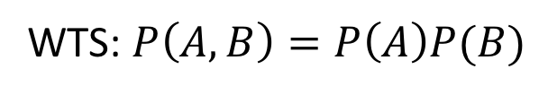
Independent variables
Example
A and B are independently distributed. How can we prove it from their joint probability table?
WTS: $P\left(A,B\right)=P\left(A\right)P(B)$
 | $$B$$ | $$¬B$$
$$A$$ | 0.12 | 0.28
$$¬A$$ | 0.18 | 0.42
0.3
0.7

Slide 9
Independent variables
Example
A and B are independently distributed. How can we prove it from their joint probability table?
WTS: $P\left(A,B\right)=P\left(A\right)P(B)$
 | $$B$$ | $$¬B$$
$$A$$ | 0.12 | 0.28
$$¬A$$ | 0.18 | 0.42
0.4
0.6
0.3
0.7

Slide 10
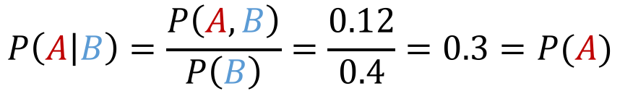
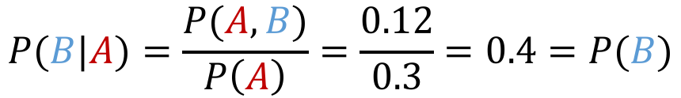
Independent variables
Example
A and B are independently distributed. How can we prove it from their joint probability table?
WTS: $P\left(A,B\right)=P\left(A\right)P(B)$
 | $$B$$ | $$¬B$$
$$A$$ | 0.12 | 0.28
$$¬A$$ | 0.18 | 0.42
$$P\left(A | B\right)=\frac{P\left(A,B\right)}{P\left(B\right)}=\frac{0.12}{0.4}=0.3=P(A)$$
0.4
0.6
$$P(B|A)=\frac{P(A,B)}{P\left(A\right)}=\frac{0.12}{0.3}=0.4=P(B)$$
0.3
0.7

Slide 11
Independent variables
Example
A and B are independently distributed. How can we prove it from their joint probability table?
WTS: $P\left(A,B\right)=P\left(A\right)P(B)$
 | $$B$$ | $$¬B$$
$$A$$ | 0.12 | 0.28
$$¬A$$ | 0.18 | 0.42
$$P\left(A | B\right)=\frac{P\left(A,B\right)}{P\left(B\right)}=\frac{0.12}{0.4}=0.3=P(A)$$
0.4
0.6
$$P(B|A)=\frac{P(A,B)}{P\left(A\right)}=\frac{0.12}{0.3}=0.4=P(B)$$
0.3
0.7

Slide 12

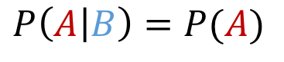
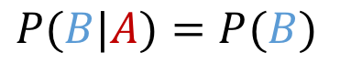
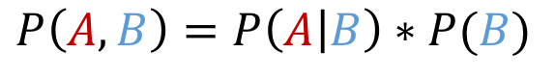
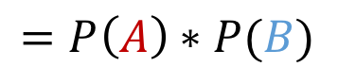
Independent variables
Example
A and B are independently distributed. How can we prove it from their joint probability table?
WTS: $P\left(A,B\right)=P\left(A\right)P(B)$
 | $$B$$ | $$¬B$$
$$A$$ | 0.12 | 0.28
$$¬A$$ | 0.18 | 0.42
$$P\left(A | B\right)=P(A)$$
$$P(B|A)=P(B)$$
0.4
0.6
$$P\left(A,B\right)=P\left(A | B\right)∗P(B)$$
$$=P\left(A\right)∗P(B)$$
0.3
0.7

Slide 13
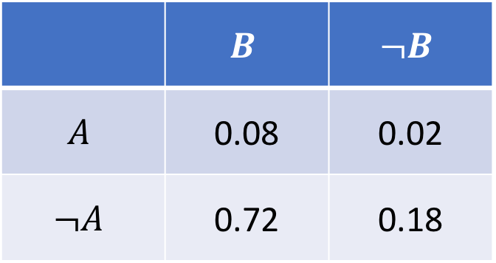
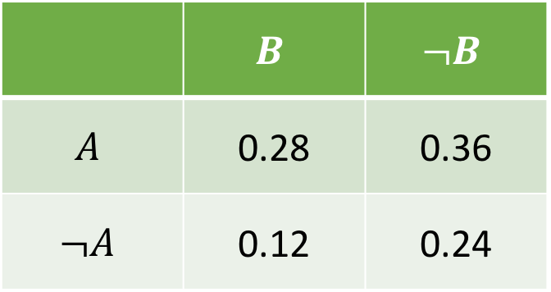
Independence - Practice
Left
Right
 | $$B$$ | $$¬B$$
$$A$$ | 0.28 | 0.36
$$¬A$$ | 0.12 | 0.24
 | $$B$$ | $$¬B$$
$$A$$ | 0.08 | 0.02
$$¬A$$ | 0.72 | 0.18
Are A and B independent in either of these tables?

Slide 14
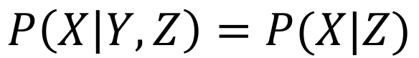
Conditional independence
True independence is pretty rare. But, conditional independence is another helpful assumption that works much more often!
For random variables X, Y, and Z, we say that X is conditionally independent of Y given Z if:
$$P\left(X | Y,Z\right)=P(X|Z)$$

Slide 15
Example: visiting the dentist
Three random variables to consider:
Cavity – you have a cavity
Toothache – you have a toothache
Catches – the dentist catches something on your tooth
By world knowledge:
Toothaches are more likely when you have a cavity
But the dentist is equally likely to catch on any tooth

Slide 16
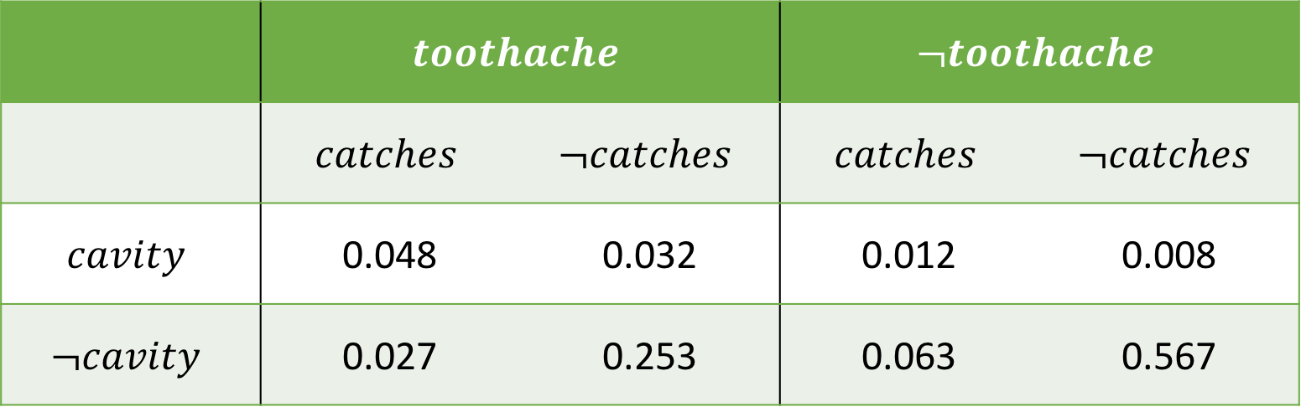
Example: visiting the dentist
 | $$toothache$$ |  | $$¬toothache$$
 | $$catches$$ | $$¬catches$$ | $$catches$$ | $$¬catches$$
$$cavity$$ | 0.048 | 0.032 | 0.012 | 0.008
$$¬cavity$$ | 0.027 | 0.253 | 0.063 | 0.567
$P\left(catches | cavity,toothache\right)=P(catches|cavity)$???

Slide 17

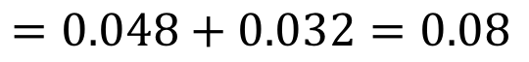
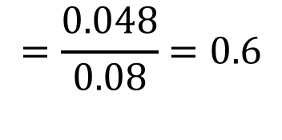
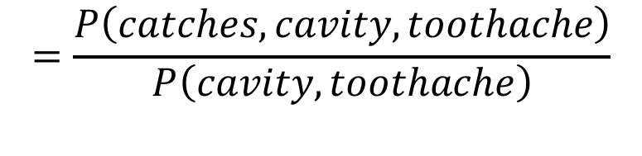
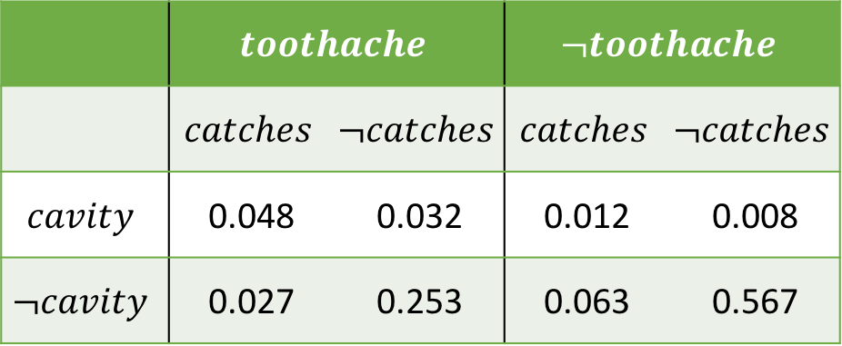
Example: visiting the dentist
 | $$toothache$$ |  | $$¬toothache$$
 | $$catches$$ | $$¬catches$$ | $$catches$$ | $$¬catches$$
$$cavity$$ | 0.048 | 0.032 | 0.012 | 0.008
$$¬cavity$$ | 0.027 | 0.253 | 0.063 | 0.567
$$=\frac{P\left(catches,cavity,toothache\right)}{P\left(cavity,toothache\right)}$$
$$=\frac{0.048}{0.08}=0.6$$
$$P\left(catches | cavity,toothache\right)$$
$$P\left(cavity,toothache\right)=P\left(cavity,toothache,catches\right)+P(cavity,toothache,¬catches)$$
$$=0.048+0.032=0.08$$

Slide 18
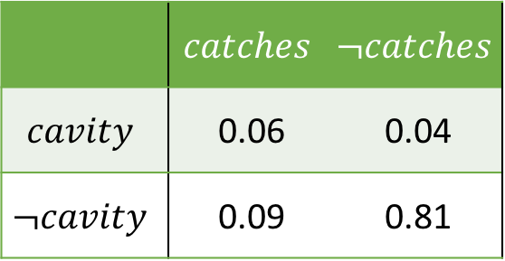
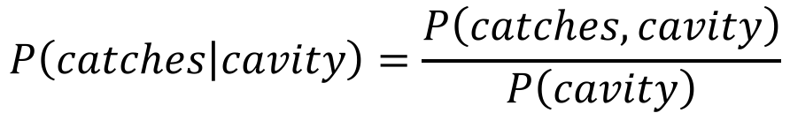
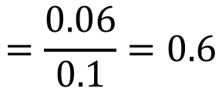
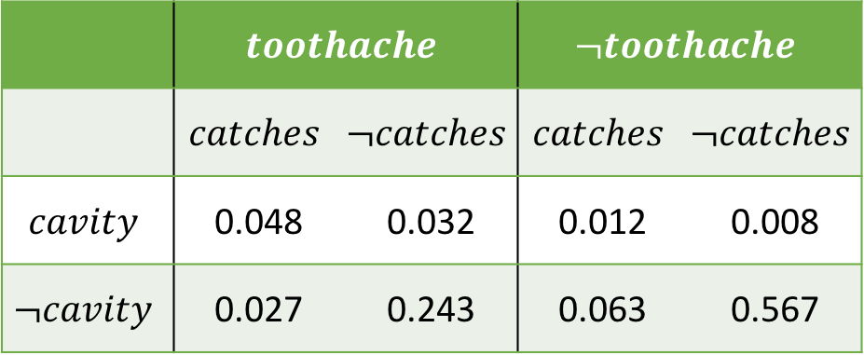
Example: visiting the dentist
 | $$toothache$$ |  | $$¬toothache$$
 | $$catches$$ | $$¬catches$$ | $$catches$$ | $$¬catches$$
$$cavity$$ | 0.048 | 0.032 | 0.012 | 0.008
$$¬cavity$$ | 0.027 | 0.243 | 0.063 | 0.567
 | $$catches$$ | $$¬catches$$
$$cavity$$ | 0.06 | 0.04
$$¬cavity$$ | 0.09 | 0.81
Want to calculate $P(catches|cavity)$ for comparison.
Marginalize over Toothache!
$$P\left(catches | cavity\right)=\frac{P\left(catches,cavity\right)}{P\left(cavity\right)}$$
$$=\frac{0.06}{0.1}=0.6$$
$$P\left(cavity\right)=P\left(cavity,catches\right)+P\left(cavity,¬catches\right)=0.06+0.04=0.1$$

Slide 19
Example: visiting the dentist
 | $$toothache$$ |  | $$¬toothache$$
 | $$catches$$ | $$¬catches$$ | $$catches$$ | $$¬catches$$
$$cavity$$ | 0.048 | 0.032 | 0.012 | 0.008
$$¬cavity$$ | 0.027 | 0.253 | 0.063 | 0.567
$P\left(catches | cavity,toothache\right)=P(catches|cavity)$???
0.6
0.6

Slide 20
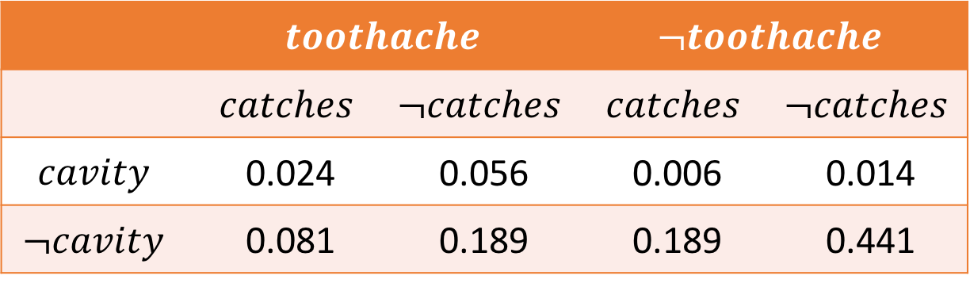
Independent variables
How do you know if two variables are truly independent?
 | $$toothache$$ |  | $$¬toothache$$
 | $$catches$$ | $$¬catches$$ | $$catches$$ | $$¬catches$$
$$cavity$$ | 0.024 | 0.056 | 0.006 | 0.014
$$¬cavity$$ | 0.081 | 0.189 | 0.189 | 0.441
In this table, $P\left(catches | cavity,toothache\right)=P\left(catches\right)=0.3$

Slide 21
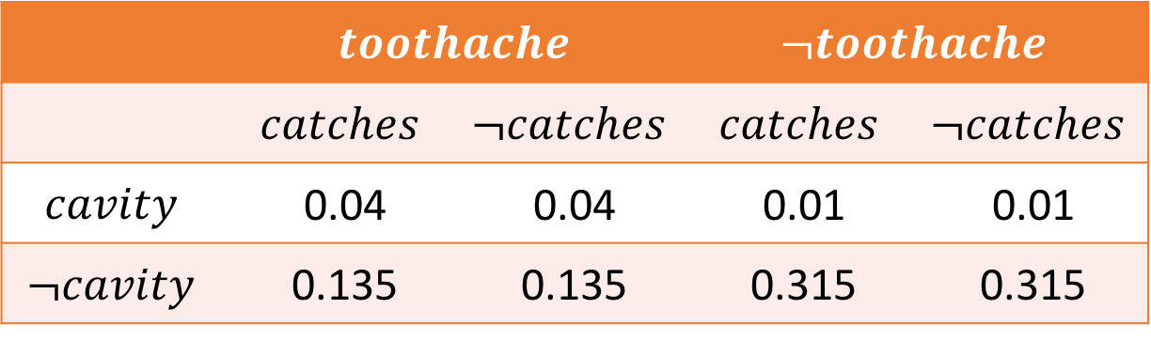
Independent variables
How do you know if two variables are truly independent?
 | $$toothache$$ |  | $$¬toothache$$
 | $$catches$$ | $$¬catches$$ | $$catches$$ | $$¬catches$$
$$cavity$$ | 0.04 | 0.04 | 0.01 | 0.01
$$¬cavity$$ | 0.135 | 0.135 | 0.315 | 0.315
In this even clearer table, $P\left(catches | cavity,toothache\right)=P\left(catches\right)=0.5$
Does this mean that Catches is an independent variable?

Slide 22
Independence assumptions
Independence can’t be determined from observation!
Remember that any distribution you observe is a model of some underlying ground truth distribution.
Models are inherently imperfect
Quality of the model improves with the number of observations, but is never perfect
Remember the die roll graphs from last time
Note that if you’re given the true underlying distribution, you can calculate independence and conditional independence using their definitions.
This is what we did in the examples!

Slide 23
Independence assumptions
Instead, we make assumptions about independence.
We can do this based on:
Common sense (e.g., dentist example)
Deciding what information we want to focus on (upcoming example)

Slide 24
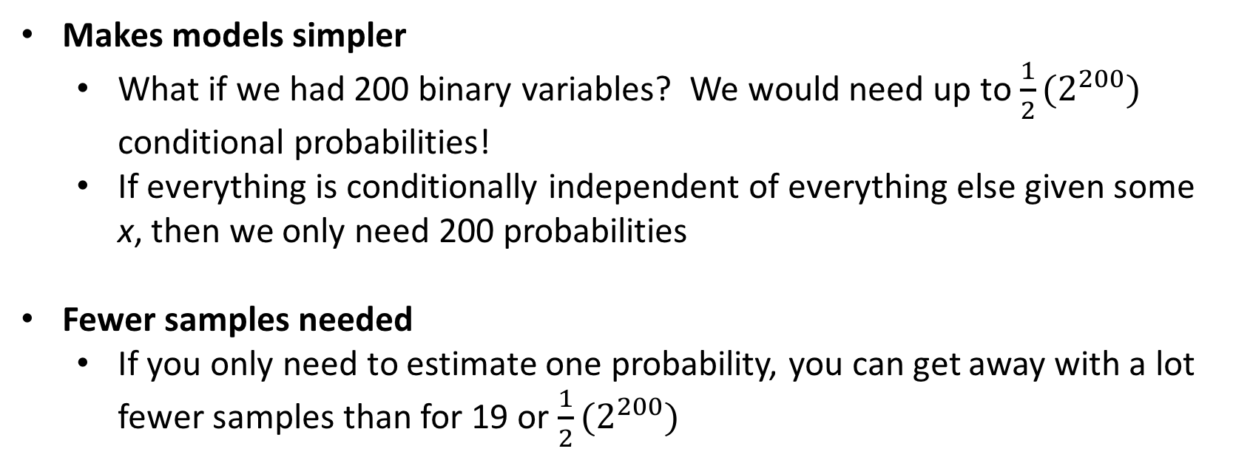
Why make independence assumptions?
These assumptions are useful for two main reasons:
Makes models simpler
What if we had 200 binary variables? We would need up to ${\frac{1}{2}(2}^{200})$ conditional probabilities!
If everything is conditionally independent of everything else given some x, then we only need 200 probabilities
Fewer samples needed
If you only need to estimate one probability, you can get away with a lot fewer samples than for 19 or ${\frac{1}{2}(2}^{200})$

Slide 25
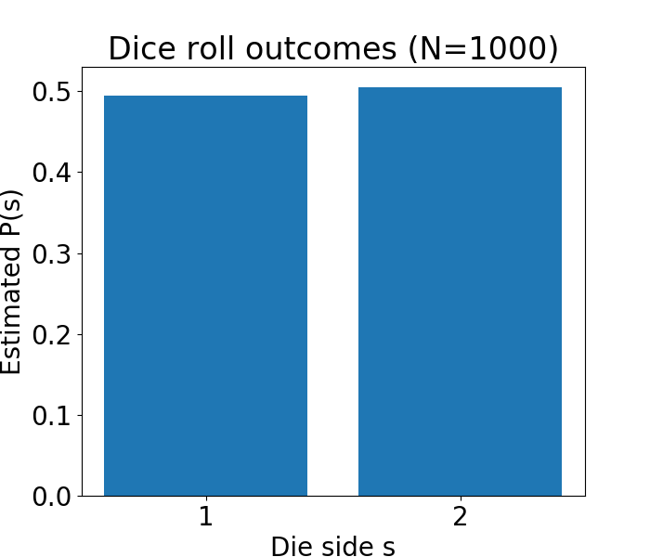
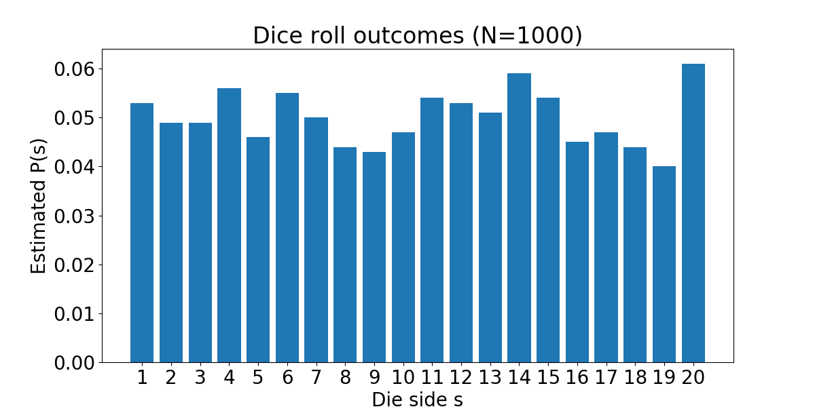
Sample size for different outcomes

Slide 26
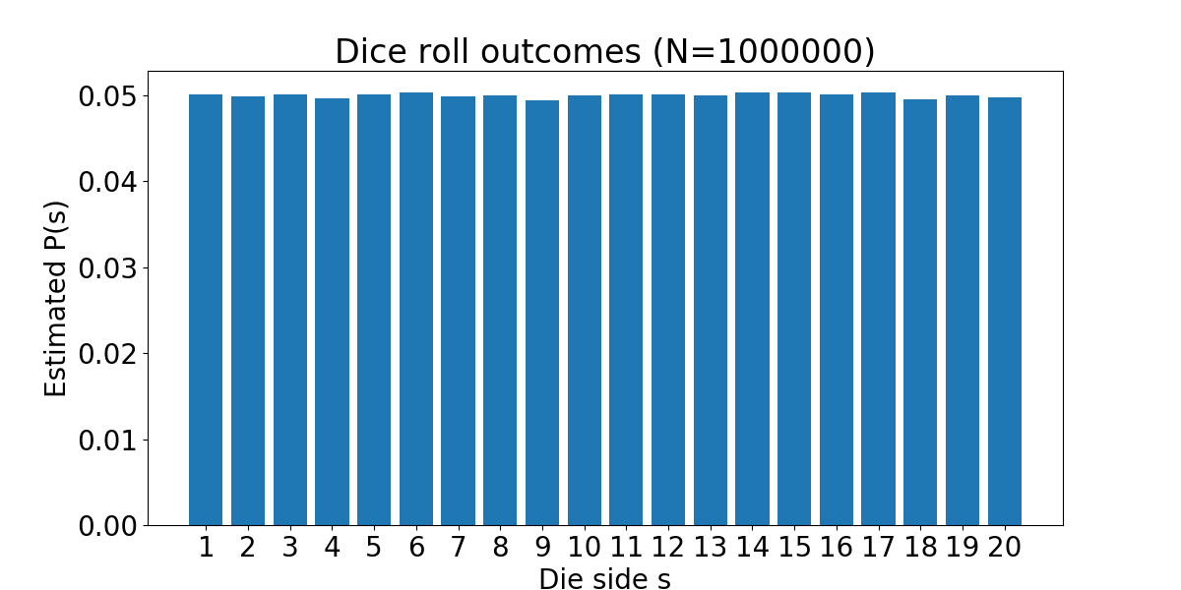
Sample size for different outcomes

Slide 27
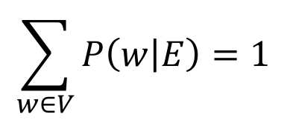
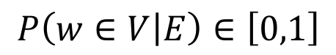
Case study: Language modeling
General idea
Given the words I’ve seen so far in a text stream, what is the probability that the next word is the?
More generally, with finite vocabulary V and evidence so far E:
$$P\left(w∈V | E\right)∈\left[0,1\right]$$
$$\sum_{w∈V}{P\left(w | E\right)=1}$$
s.t.

Slide 28
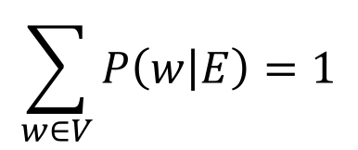
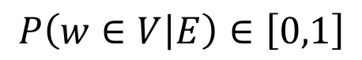
Case study: Language modeling
With finite vocabulary V and evidence so far E:
$$\sum_{w∈V}{P\left(w | E\right)=1}$$
$$P\left(w∈V | E\right)∈\left[0,1\right]$$
s.t.
Applications
Search/text/email completion
Determining if a sampled text comes from a particular distribution or not
E.g., Is this email spam? Are you writing a professional letter or a note to self?
Text compression

Slide 29
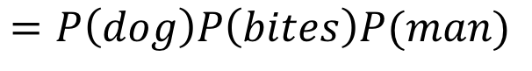
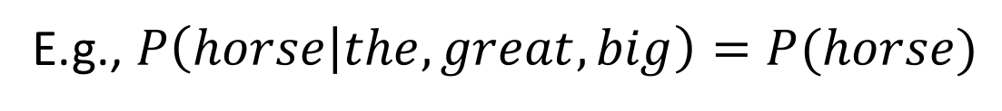
Basic 1-word language model
Everything is independent!
E.g., $P\left(horse | the,great,big\right)=P(horse)$
So, if we’re calculating the likelihood of an observed sequence:
What’s missing here?
$$P\left(man,bites,dog\right)=P\left(man\right)P\left(bites\right)P(dog)$$
$$=P\left(dog\right)P\left(bites\right)P(man)$$
No word order information!

Slide 30
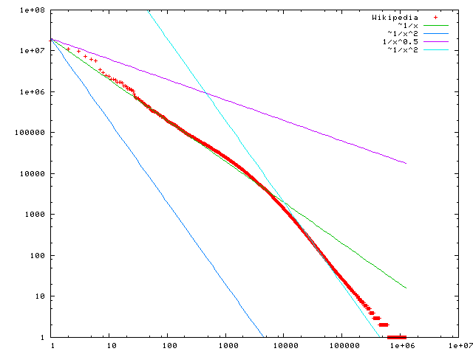
Basic 1-word language model
A plot of word frequency in Wikipedia (November 27, 2006). The plot is in log-log coordinates. x is rank of a word in the frequency table; y is the total number of the word’s occurrences.
Graph by Victor Grishchenko - Victor Grishchenko [1], LGPL, https://commons.wikimedia.org/w/index.php?curid=1415459

Slide 31
Language modeling without independence
The probability of every sequence must be calculated separately
$$P\left(the,big,yellow,dog,jumped,over,the,cat\right)$$
$$=P\left(cat | the,over,jumped,dog,yellow,big,the\right)P\left(the | over…\right)…$$
The number of times we’ve observed “the big yellow dog jumped over the” is probably pretty low.
Plus, we can’t generalize to “a big yellow dog jumped over the cat”

Slide 32
n-gram language model
Assume that each word is only dependent on the previous n-1 words
Example
$$P\left(the,big,yellow,dog,jumped,over,the,cat\right)$$
For a 2-gram model:
$$=P\left(cat | the\right)P\left(the | over\right)P\left(over | jumped\right)…$$
Or for a 3-gram model:
$$=P\left(cat | the,over\right)P\left(the | over,jumped\right)P\left(over | jumped,dog\right)…$$

Slide 33
n-gram language model
Assume that each word is only dependent on the previous n-1 words
Example
$$P\left(the,big,yellow,dog,jumped,over,the,cat\right)$$
For a 2-gram model:
$$=P\left(cat | the\right)P\left(the | over\right)P\left(over | jumped\right)…$$
Where have we seen this pattern before?

Slide 34
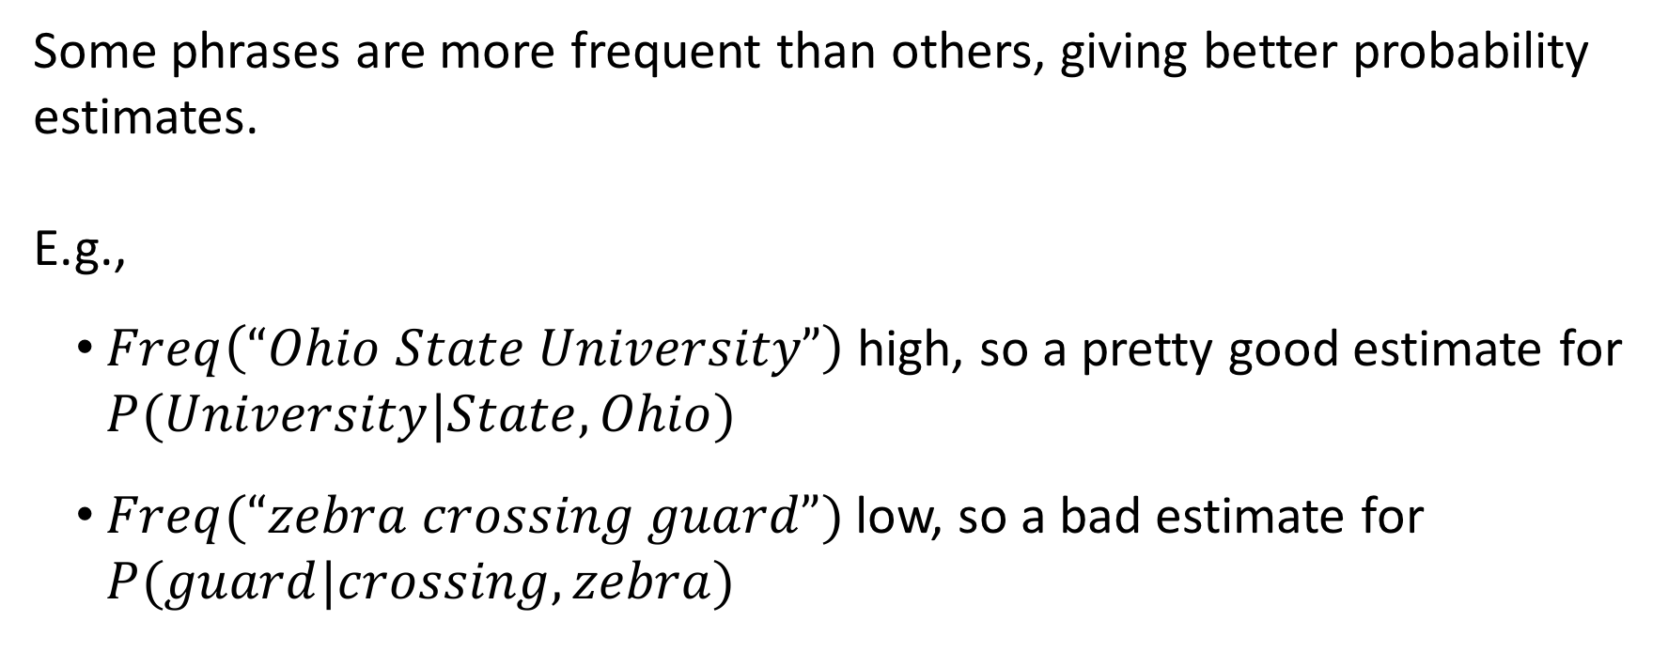
n-gram language model with backoff
Some phrases are more frequent than others, giving better probability estimates.
E.g.,
$Freq\left(“Ohio State University”\right)$ high, so a pretty good estimate for $P(University|State,Ohio)$
$Freq(“zebra crossing guard”)$ low, so a bad estimate for $P(guard|crossing,zebra)$

Slide 35
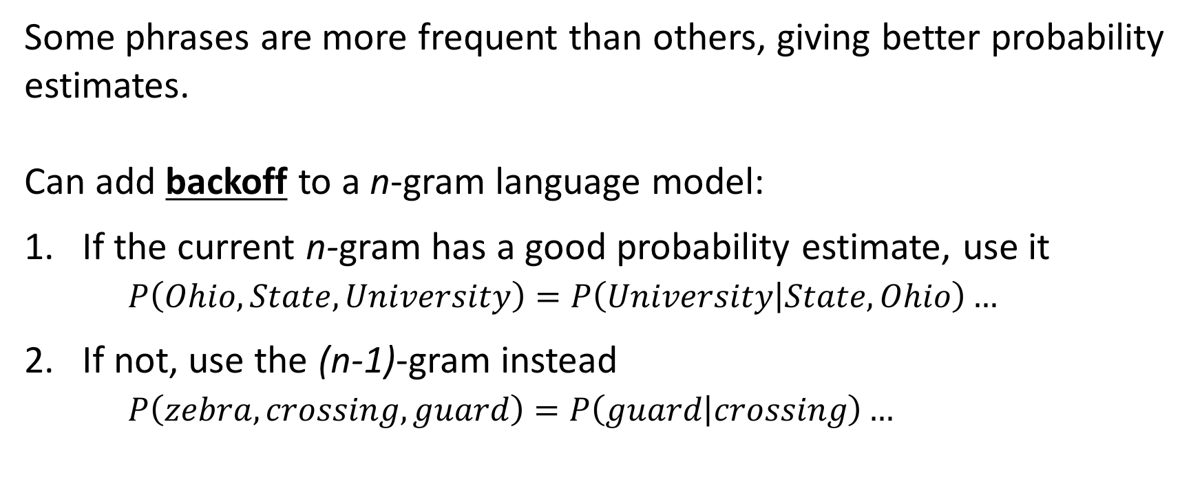
n-gram language model with backoff
Some phrases are more frequent than others, giving better probability estimates.
Can add backoff to a n-gram language model:
If the current n-gram has a good probability estimate, use it $P\left(Ohio,State,University\right)=P\left(University | State,Ohio\right)…$
If not, use the (n-1)-gram instead $P\left(zebra,crossing,guard\right)=P\left(guard | crossing\right)…$
This is what your phone does!

Slide 36
How many samples do you need?
$Freq\left(“Ohio State University”\right)$ high, so a pretty good estimate for $P(University|State,Ohio)$
How high is “high”?
How good is “pretty good”?
No straightforward answer!
A couple of semi-reasonable heuristics:
1,000,000 samples is usually a good place to start
1,000 samples per model parameter often gives a pretty good estimate
BUT, neither of these comes with any sort of guarantee!

Slide 37
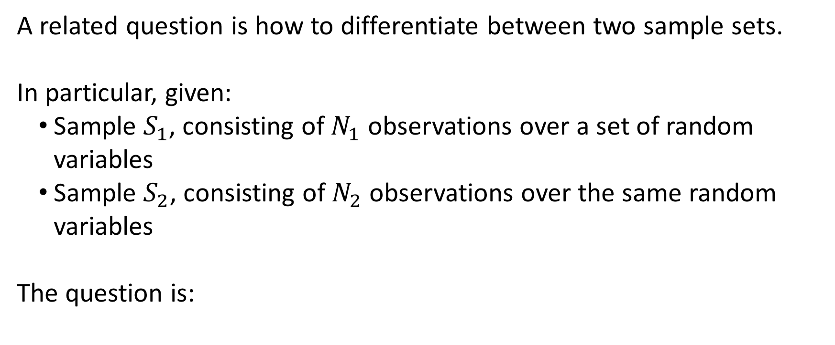

Telling if two distributions are different
A related question is how to differentiate between two sample sets.
In particular, given:
Sample $S_{1}$, consisting of $N_{1}$ observations over a set of random variables
Sample $S_{2}$, consisting of $N_{2}$ observations over the same random variables
The question is:
What is the likelihood that $S_{1}$ and $S_{2}$ came from the same underlying distribution?

Slide 38
Hypothesis testing
This question is approached via hypothesis testing.
The general approach is:
Formulate the null and alternative hypotheses
Choose a test statistic and significance level for determining which hypothesis is supported by evidence
These may be chosen based on assumptions about the problem
Compare observed distribution and reference distribution from test statistic to see if they are statistically significantly different

Slide 39


Hypothesis testing
Considering $S_{1}$ and $S_{2}$, this might look like the following:
Step 1: Formulate hypotheses
Null hypothesis $H_{0}$: $S_{1}$ and $S_{2}$ were sampled from the same underlying distribution.
Alternative hypothesis $H_{1}$: $S_{1}$ and $S_{2}$ were sampled from different underlying distributions.

Slide 40
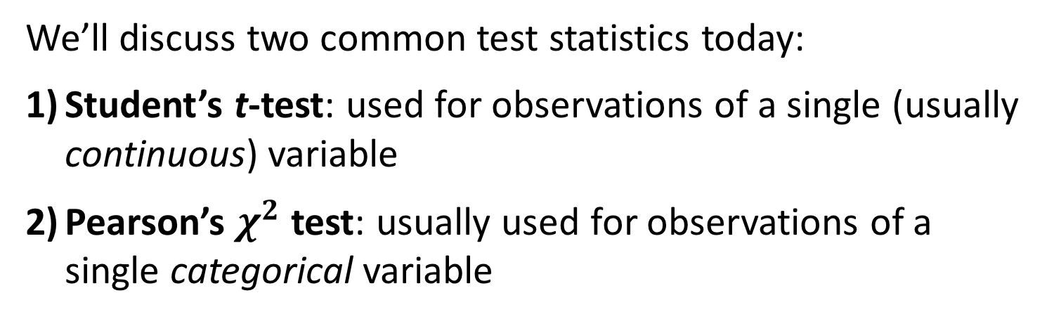
Hypothesis testing
Considering $S_{1}$ and $S_{2}$, this might look like the following:
Step 2a: Choose test statistic
We’ll discuss two common test statistics today:
Student’s t-test: used for observations of a single (usually continuous) variable
Pearson’s $χ^{2}$ test: usually used for observations of a single categorical variable

Slide 41
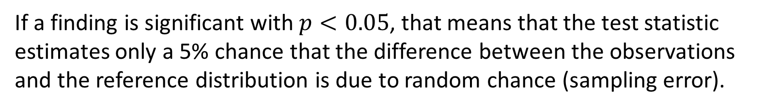
Hypothesis testing
Considering $S_{1}$ and $S_{2}$, this might look like the following:
Step 2b: Choose a significance level
Most commonly, $p<0.05$ or $p<0.01$ is chosen.
What does this mean?
If a finding is significant with $p<0.05$, that means that the test statistic estimates only a 5% chance that the difference between the observations and the reference distribution is due to random chance (sampling error).

Slide 42
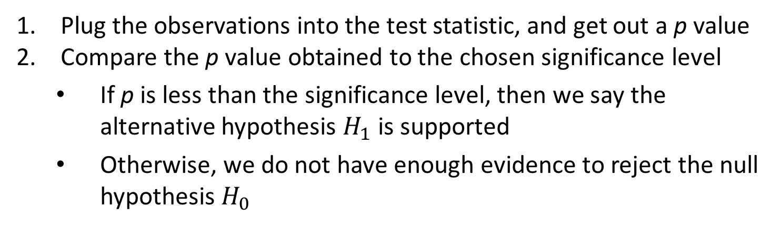
Hypothesis testing
Considering $S_{1}$ and $S_{2}$, this might look like the following:
Step 3: Evaluate the observed distribution using the test statistic
Plug the observations into the test statistic, and get out a p value
Compare the p value obtained to the chosen significance level
If p is less than the significance level, then we say the alternative hypothesis $H_{1}$ is supported
Otherwise, we do not have enough evidence to reject the null hypothesis $H_{0}$

Slide 43
Remember: significance is NOT proof

Slide 44
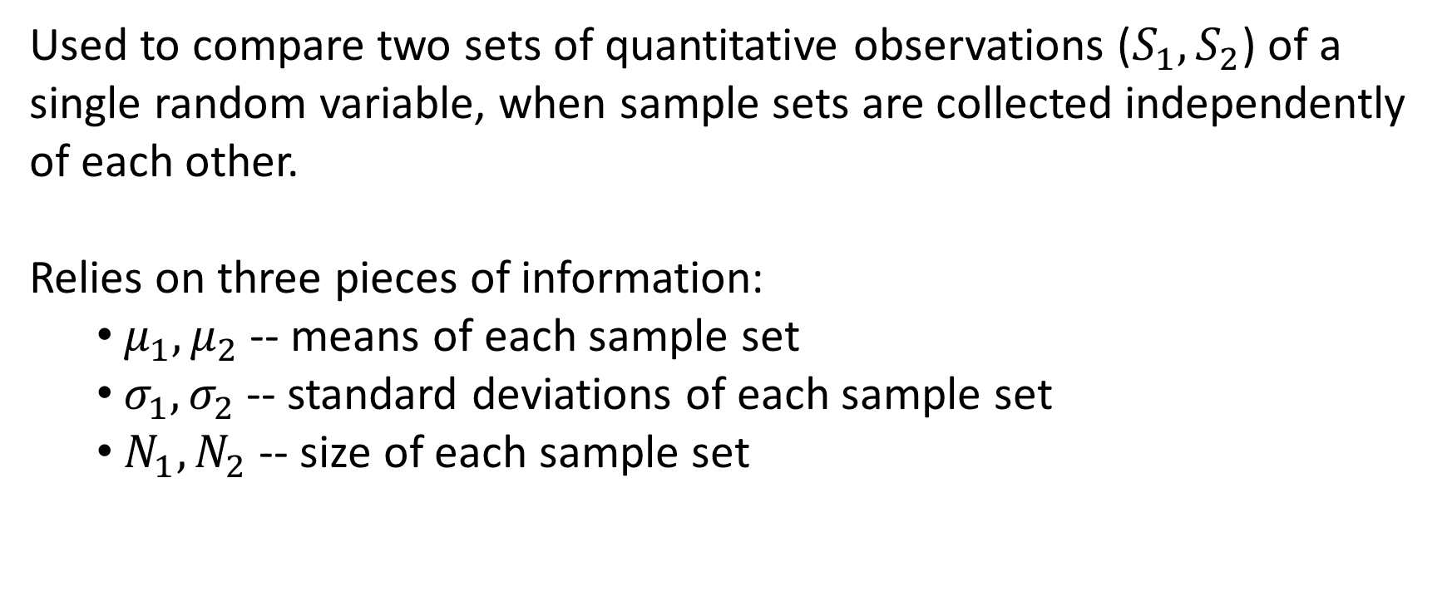
Student’s t-test
Used to compare two sets of quantitative observations ($S_{1},S_{2}$) of a single random variable, when sample sets are collected independently of each other.
Relies on three pieces of information:
$μ_{1},μ_{2}$ -- means of each sample set
$σ_{1},σ_{2}$ -- standard deviations of each sample set
$N_{1},N_{2}$ -- size of each sample set

Slide 45




Student’s t-test
Calculated as:
$$t=\frac{\left|μ_{1}−μ_{2}\right|}{\sqrt{A∗B}}$$
Where:
$$A=\frac{N_{1}+N_{2}}{N_{1}∗N_{2}}$$
$$B=\frac{\left[\left(N_{1}−1\right)σ_{1}^{2}+\left(N_{2}−1\right)σ_{2}^{2}\right]}{N_{1}+N_{2}−2}$$
Resulting t value can be compared against a pre-established critical value for the given significance level (tables available anywhere); if greater, $H_{1}$ is supported
Critical values specified for degrees of freedom ($N_{1}+N_{2}−2)$

Slide 46

Example: are these RL problems different?
$S_{1}$: Q values learned for RL problem 1
$N_{1}=400$
$μ_{1}=0.08$
$σ_{1}=0.38$
$S_{2}$: Q values learned for RL problem 2
$N_{2}=800$
$μ_{2}=0.12$
$σ_{2}=0.33$
Using
Student’s t test
Significance level 0.05

Slide 47





Example: are these RL problems different?
$$N_{1}=400$$
$$μ_{1}=0.08$$
$$σ_{1}=0.38$$
$$N_{2}=800$$
$$μ_{2}=0.12$$
$$σ_{2}=0.33$$
$$DoF=1198$$
Crit Val = 1.96
$$A=\frac{N_{1}+N_{2}}{N_{1}∗N_{2}}=\frac{400+800}{400∗800}=0.00375$$
$$B=\frac{\left[\left(N_{1}−1\right)σ_{1}^{2}+\left(N_{2}−1\right)σ_{2}^{2}\right]}{N_{1}+N_{2}−2}$$
$$=\frac{\left[\left(400−1\right){0.38}^{2}+\left(800−1\right){0.33}^{2}\right]}{400+800−2}≈0.121$$
$$t=\frac{\left|μ_{1}−μ_{2}\right|}{\sqrt{A∗B}}=\frac{\left|0.08−0.12\right|}{\sqrt{0.00375∗0.121}}≈1.88$$
Since 1.88 < 1.96, we cannot reject the null hypothesis (that the two problems are the same).

Slide 48


Pearson’s $χ^{2}$ test
Used to compare two sets of categorical observations ($S_{1},S_{2}$) of a single random variable.
With category set C, relies on:
$X_{1},X_{2}$ -- frequency of each category $c∈C$ in each sample set
Note
This can also be formulated for a single sample set and expected distribution in terms of:
N – size of the sample set
$E_{c}=Np_{c}$ -- expected frequency of category c under the expected distribution
$O_{c}$ -- observed frequency of category c in the sample set

Slide 49


Pearson’s $χ^{2}$ test
Calculated as:
$$χ^{2}=\sum_{i=1}^{|C|}{\frac{{\left(X_{2,i}−X_{1,i}\right)}^{2}}{X_{1,i}}}$$
Where $X_{1,i}$ is the frequency of category $i$ in $X_{1}$ (and the same for $X_{2}$)
Note that this is not symmetric; if using two actual observed distributions, $X_{1}$ is considered the “expected” distribution
As with Student’s t test, compare calculated $χ^{2}$ value against the critical value specified for the degrees of freedom (here $\left|C\right|−1$)
This breaks if any expected $X_{1,i}<10$

Slide 50






Example: Is an email classifier different from random?
$$C=\{Spam,Important,Other\}$$
$$N=600$$
$$X_{2,Spm}=200$$
$$X_{2,Imp}=100$$
$$X_{2,Oth}=300$$
$$X_{1,Spm}=200$$
$$X_{1,Imp}=200$$
$$X_{1,Oth}=200$$
$$DoF=2$$
Crit Val = 5.991
Significance = 0.05
$$χ^{2}=\sum_{i=1}^{|C|}{\frac{{\left(X_{2,i}−X_{1,i}\right)}^{2}}{X_{1,i}}}$$
$$=\frac{{\left(200−200\right)}^{2}}{200}+\frac{{\left(100−200\right)}^{2}}{200}+\frac{{\left(300−200\right)}^{2}}{200}$$
$$=100>5.991$$
Here, we reject $H_{0}$ and say that the email classifier is different from random.

Slide 51




Example: Is one email classifier different from another?
$$C=\{Spam,Important,Other\}$$
$$X_{2,Spm}=200$$
$$X_{2,Imp}=100$$
$$X_{2,Oth}=300$$
$$X_{1,Spm}=50$$
$$X_{1,Imp}=400$$
$$X_{1,Oth}=400$$
$$DoF=2$$
Crit Val = 5.991
Significance = 0.05
$$χ^{2}=\sum_{i=1}^{|C|}{\frac{{\left(X_{2,i}−X_{1,i}\right)}^{2}}{X_{1,i}}}$$
$$=\frac{{\left(200−50\right)}^{2}}{50}+\frac{{\left(100−400\right)}^{2}}{400}+\frac{{\left(300−400\right)}^{2}}{400}$$
$$=700>5.991$$
Here, we reject $H_{0}$ and say that the second email classifier is different from the first.

Slide 52




Example: Is one email classifier different from another?
$$C=\{Spam,Important,Other\}$$
$$X_{2,Spm}=200$$
$$X_{2,Imp}=100$$
$$X_{2,Oth}=300$$
$$X_{1,Spm}=225$$
$$X_{1,Imp}=100$$
$$X_{1,Oth}=330$$
$$DoF=2$$
Crit Val = 5.991
Significance = 0.05
$$χ^{2}=\sum_{i=1}^{|C|}{\frac{{\left(X_{2,i}−X_{1,i}\right)}^{2}}{X_{1,i}}}$$
$$=\frac{{\left(200−225\right)}^{2}}{225}+\frac{{\left(100−100\right)}^{2}}{100}+\frac{{\left(300−330\right)}^{2}}{330}$$
$$≈5.51<5.991$$
Here, we cannot reject $H_{0}$ and must say that the second email classifier is not significantly different from the first.
Notes:
Different reference distribution

Slide 53
How many samples do we need?
Now we have one clue!
Based on:
The size of the difference (effect) you want to measure
Number of categories/samples in the reference distribution
Chosen test and significance level
We can at least start to get an idea of how many samples we’d need to call an observed difference statistically significant or not.

Slide 54

Example: doubling sample size
$$C=\{Spam,Important,Other\}$$
$$X_{2,Spm}=200$$
$$X_{2,Imp}=100$$
$$X_{2,Oth}=300$$
$$X_{1,Spm}=225$$
$$X_{1,Imp}=100$$
$$X_{1,Oth}=330$$
$$DoF=2$$
Crit Val = 5.991
Significance = 0.05
$$χ^{2}=\sum_{i=1}^{|C|}{\frac{{\left(X_{2,i}−X_{1,i}\right)}^{2}}{X_{1,i}}}$$
$$=\frac{{\left(200−225\right)}^{2}}{225}+\frac{{\left(100−100\right)}^{2}}{100}+\frac{{\left(300−330\right)}^{2}}{330}$$
$$≈5.51<5.991$$
Here, we cannot reject $H_{0}$ and must say that the second email classifier is not significantly different from the first.
Notes:
Original, not different

Slide 55




Example: doubling sample size
$$C=\{Spam,Important,Other\}$$
$$X_{2,Spm}=400$$
$$X_{2,Imp}=200$$
$$X_{2,Oth}=600$$
$$X_{1,Spm}=225$$
$$X_{1,Imp}=100$$
$$X_{1,Oth}=330$$
$$DoF=2$$
Crit Val = 5.991
Significance = 0.05
$$χ^{2}=\sum_{i=1}^{|C|}{\frac{{\left(X_{2,i}−X_{1,i}\right)}^{2}}{X_{1,i}}}$$
$$=\frac{{\left(400−225\right)}^{2}}{225}+\frac{{\left(200−100\right)}^{2}}{100}+\frac{{\left(600−330\right)}^{2}}{330}$$
$$≈457.02<5.991$$
Now we can reject $H_{0}$, because a larger sample size has made us more confident.
Notes:
Twice the samples, now it’s different

Slide 56
Significance isn’t perfect
XKCD

Slide 57
Next time
Machine learning overview

